Slide 1
AIIR 2nd Edition Groundwork
Graphical Illustrations of Signal Schemes

Slide 2
At-Grade Intersections
At-Grade Intersections

Slide 3
Phase 1
Phase 2
Phase 1
Phase 2
Phase 1
Phase 2
Phase 1
Phase 2
Phase 1
Phase 2

Slide 4
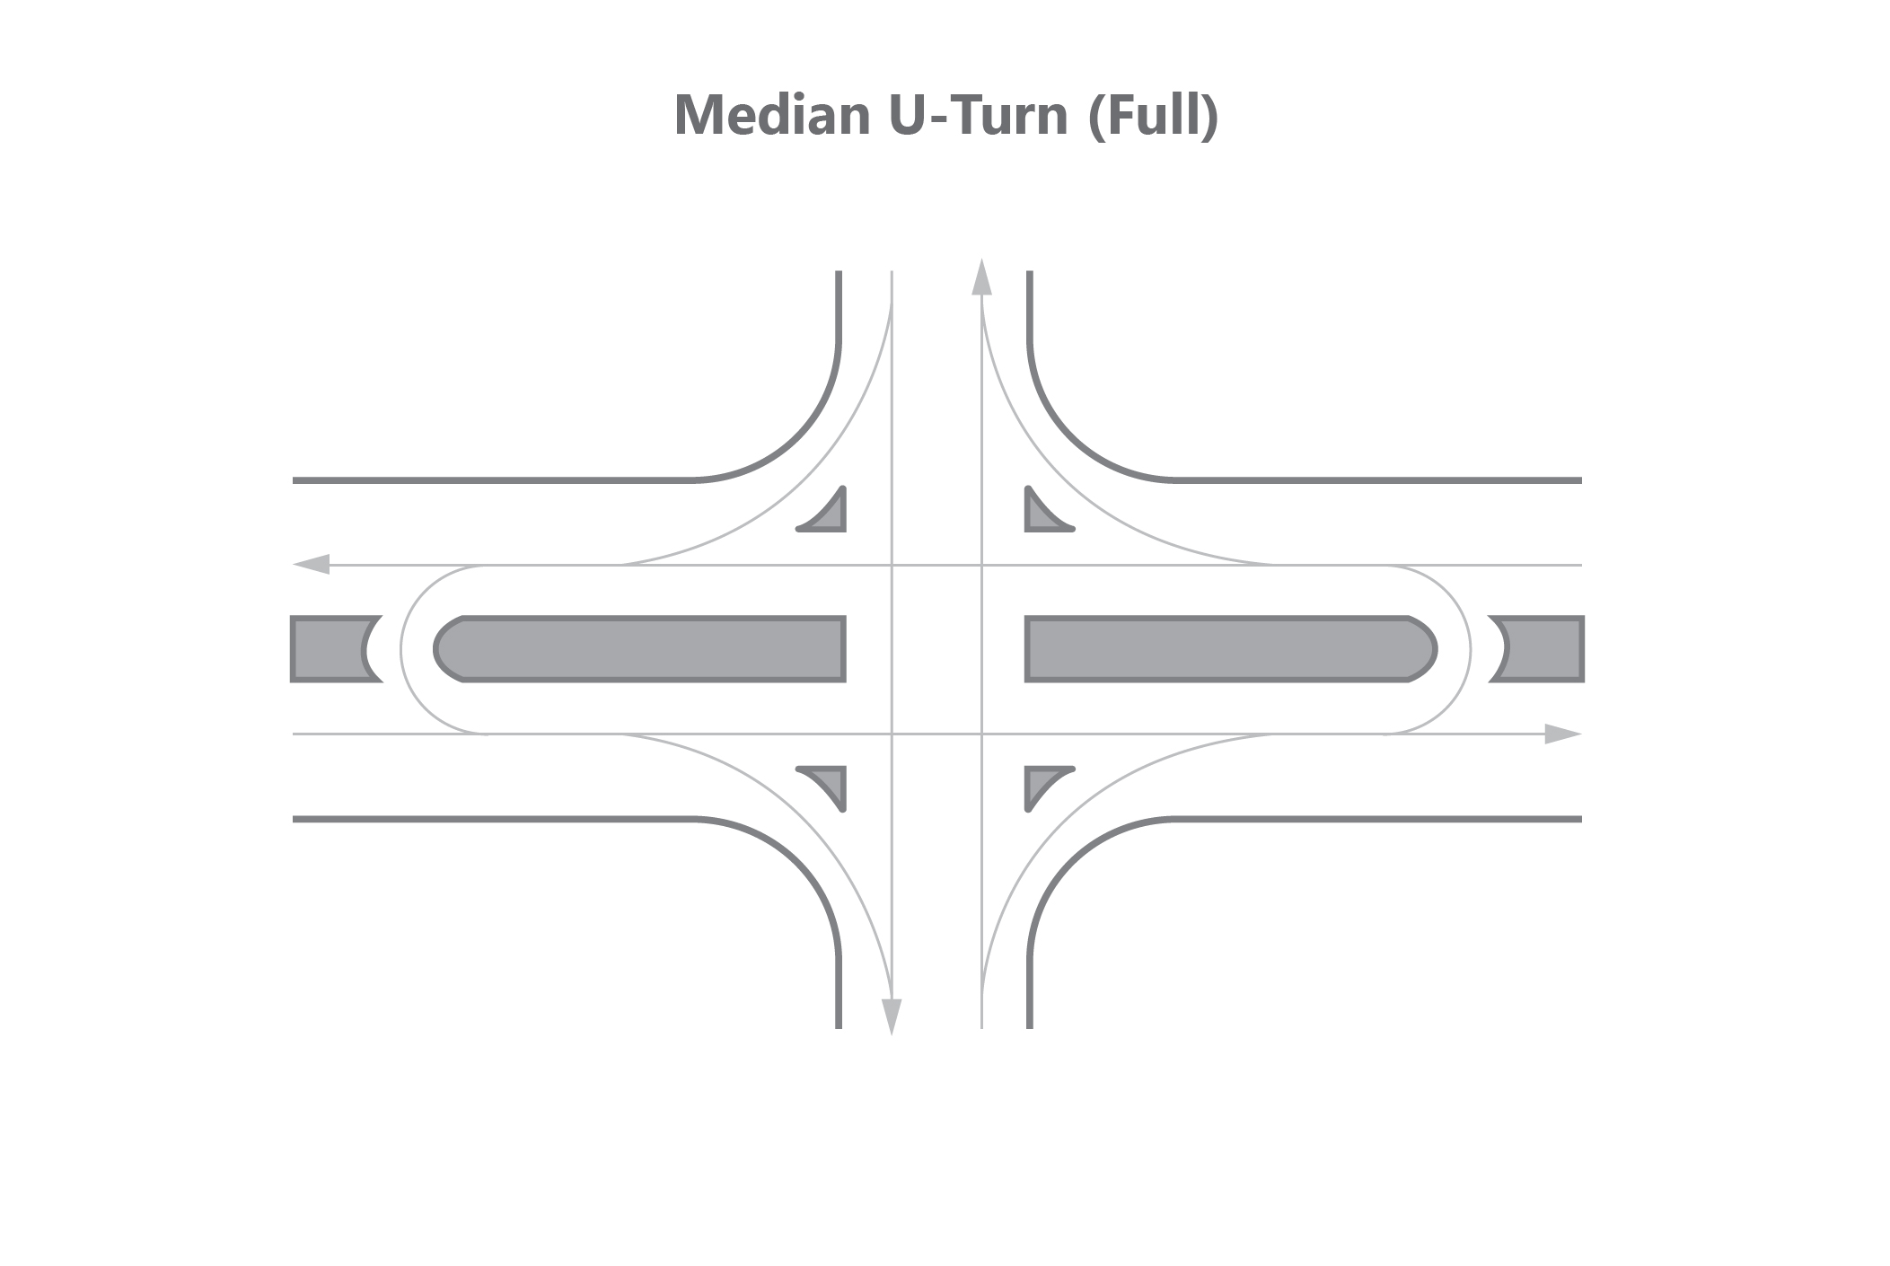
Phase 1
Phase 2
Phase 1
Phase 2
Phase 1
Phase 2

Slide 5
Phase 1
Phase 2
Phase 1
Phase 2
Phase 1
Phase 2
Phase 1
Phase 2

Slide 6
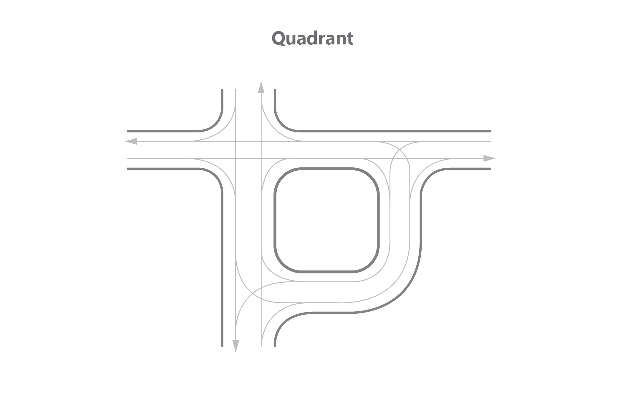
Phase 1
Phase 2
Phase 3
Phase 1
Phase 2
Phase 1
Phase 2
Phase 2
Phase 3

Slide 7
Phase 1
Phase 2
Phase 1
Phase 2
Phase 1
Phase 2
Phase 1
Phase 2
Phase 1
Phase 2

Slide 8
Phase 1
Phase 2
Phase 3
Phase 1
Phase 2
Phase 3
Phase 1
Phase 2
Phase 3

Slide 9
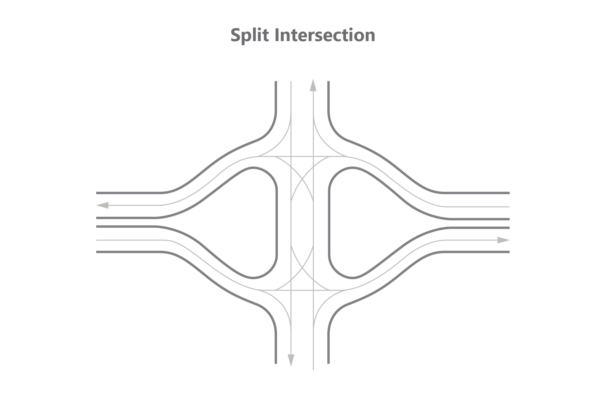
Phase 1
Phase 2
Phase 3
Phase 1
Phase 2
Phase 3

Slide 10
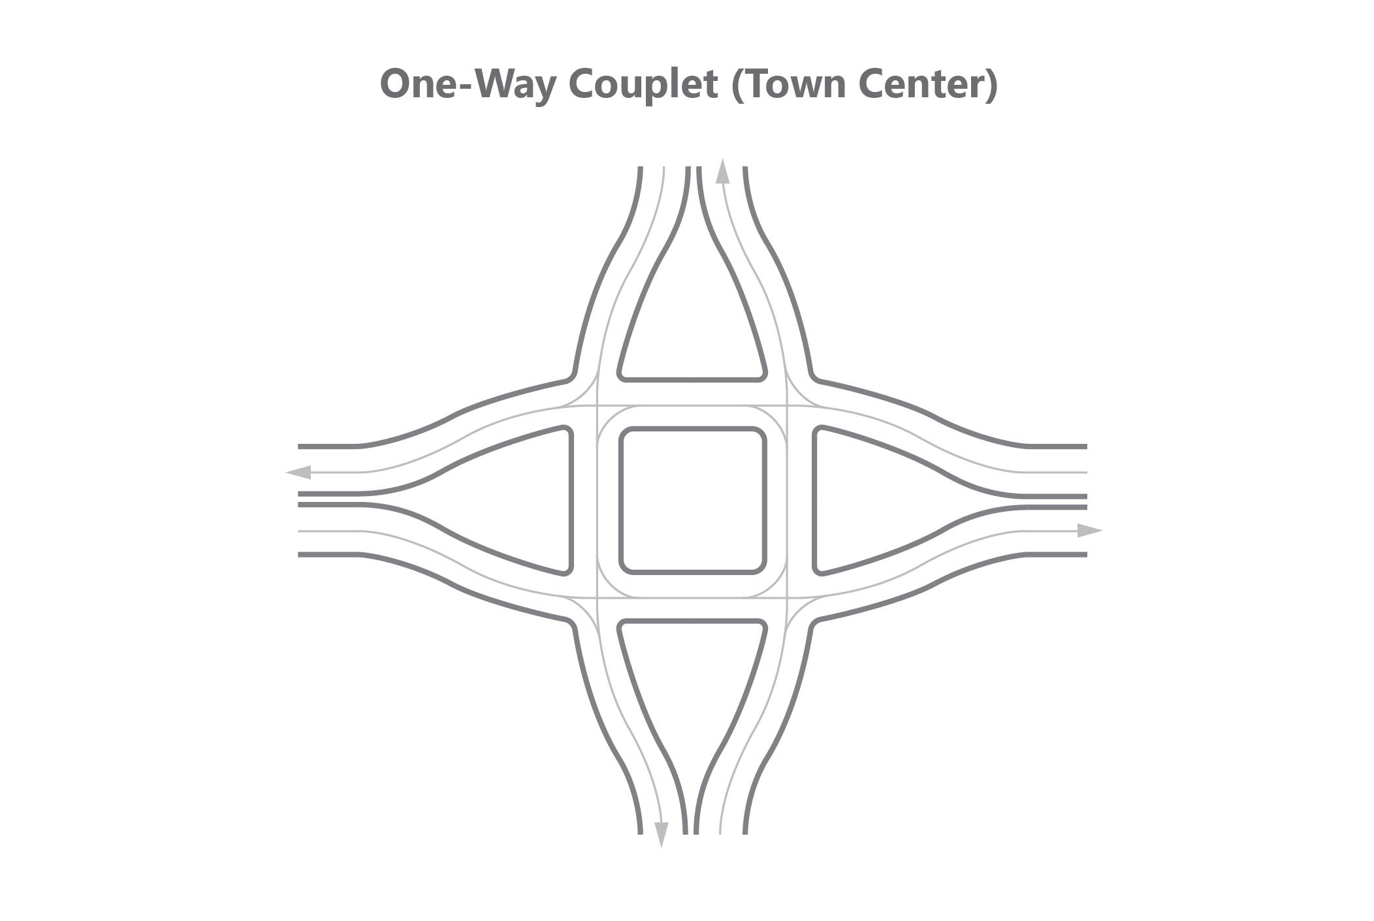
Phase 1
Phase 2
Phase 1
Phase 2
Phase 1
Phase 2
Phase 1
Phase 2

Slide 11
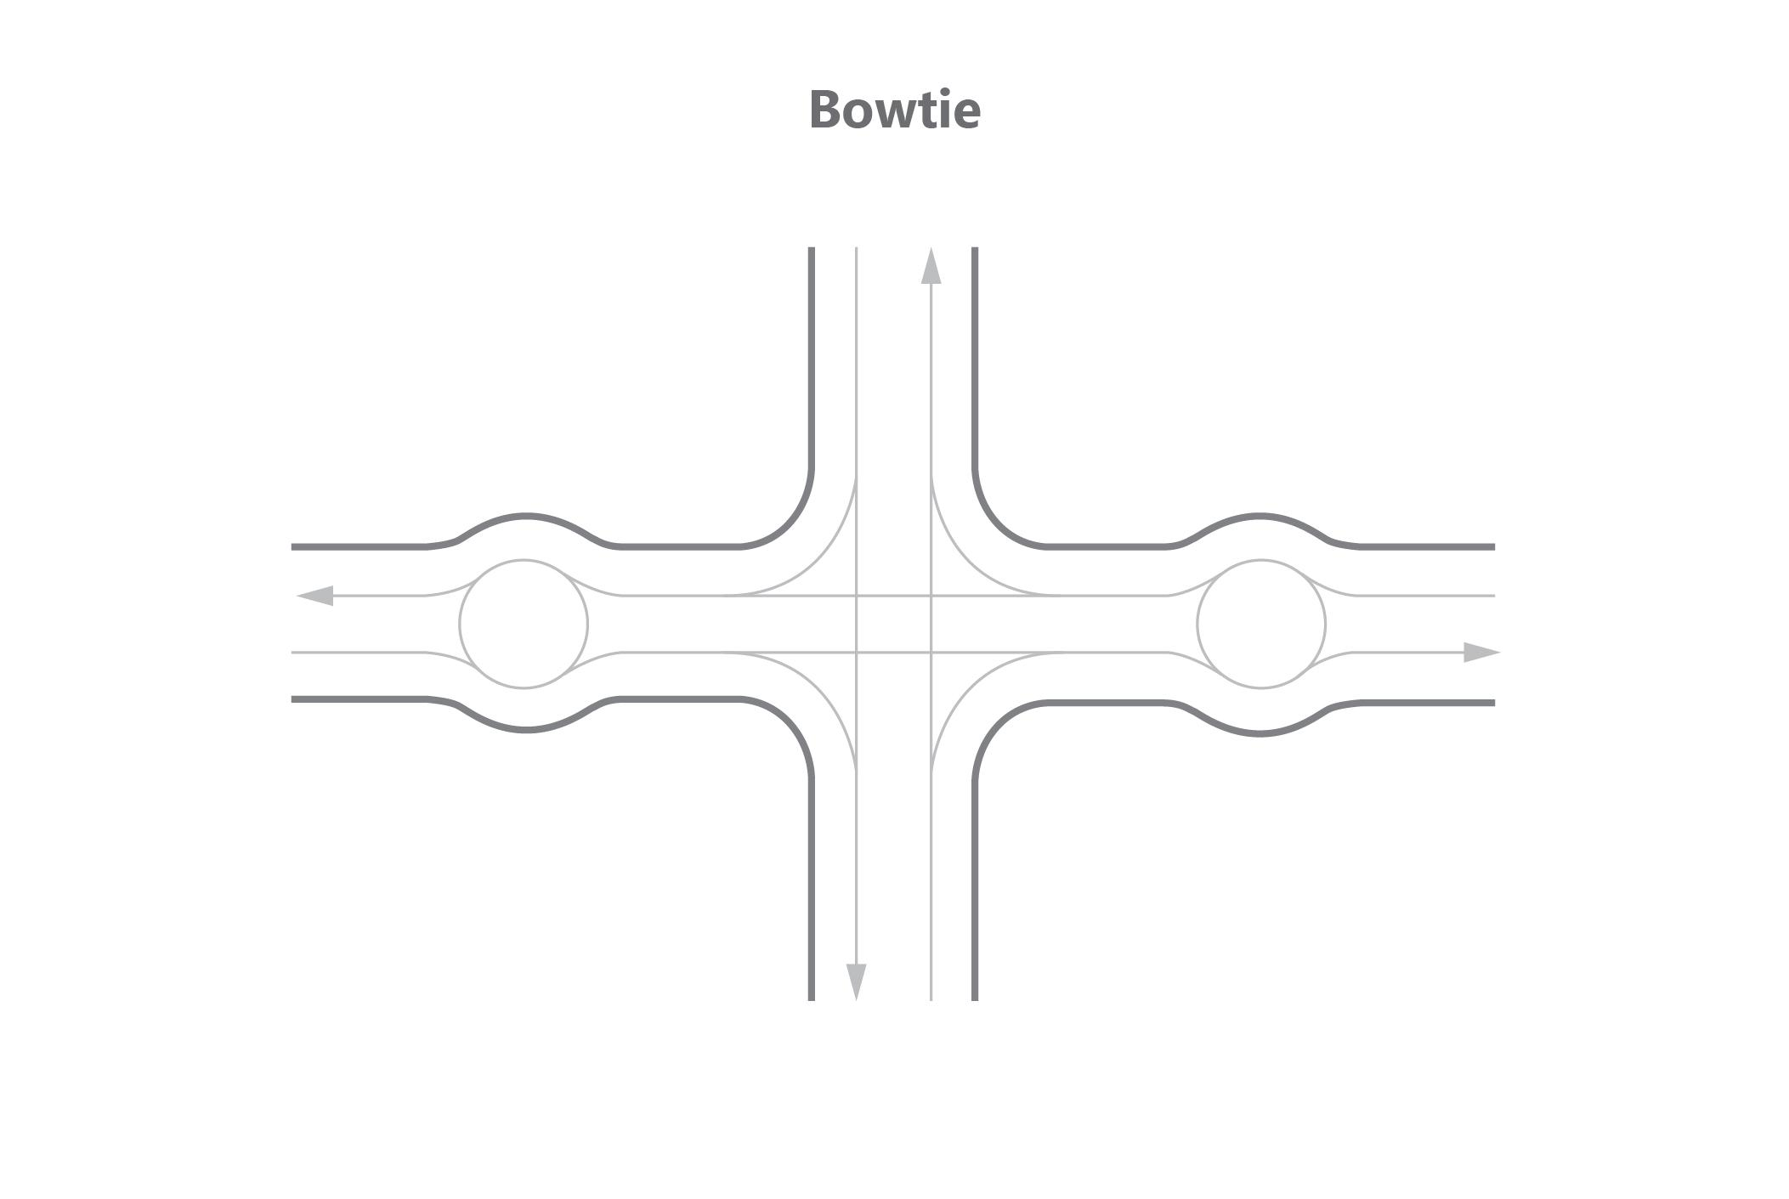
Phase 1
Phase 2

Slide 12
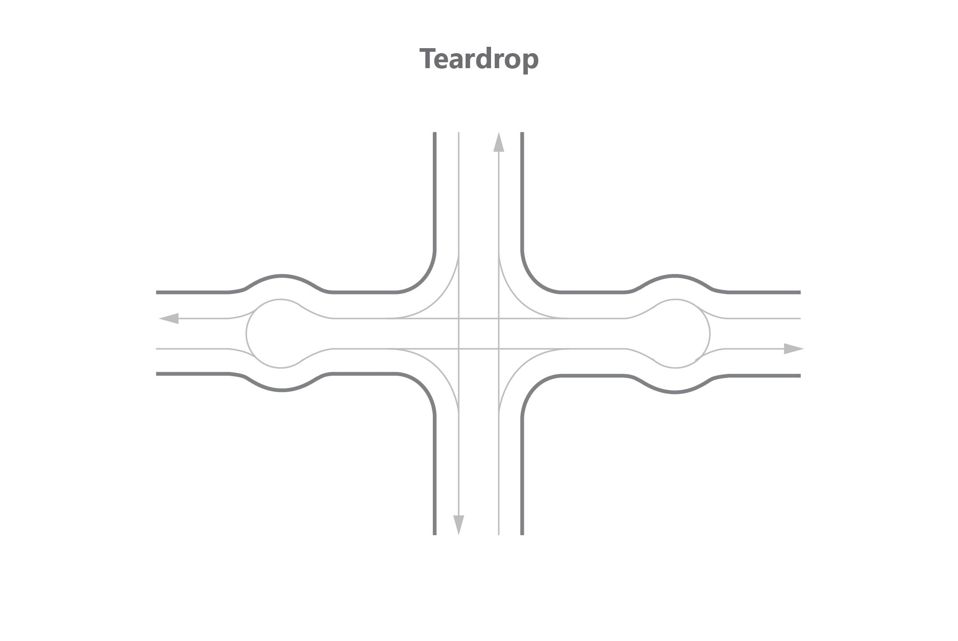
Phase 1
Phase 2

Slide 13
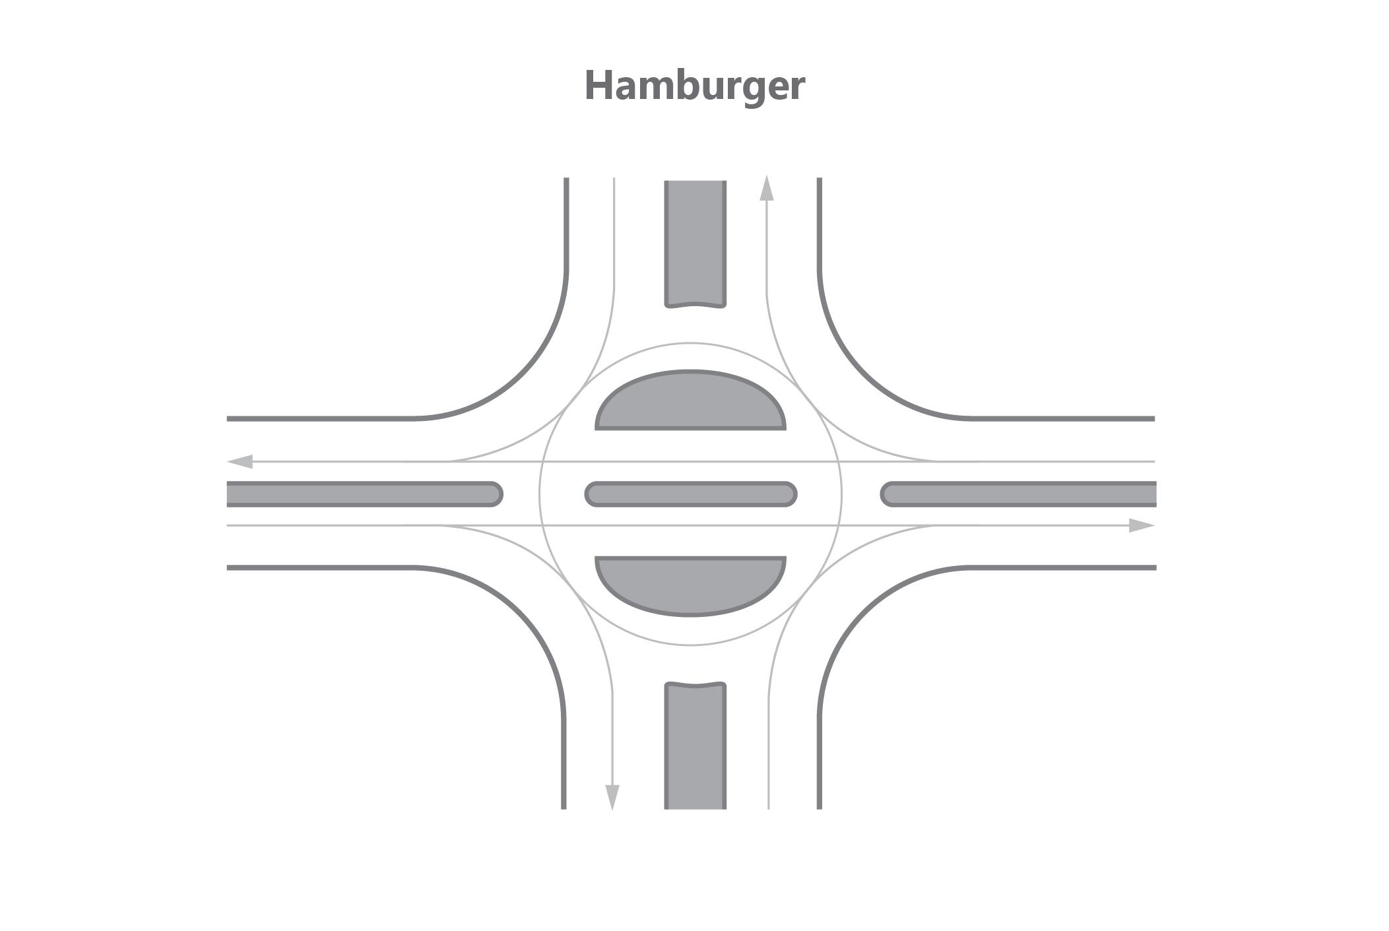
Phase 1
Phase 2
Phase 1
Phase 2

Slide 14
Phase 1
Phase 2
Phase 3
Phase 1
Phase 2
Phase 1
Phase 2

Slide 15
Phase 1
Phase 2
Phase 1
Phase 2
Phase 1
Phase 2

Slide 16
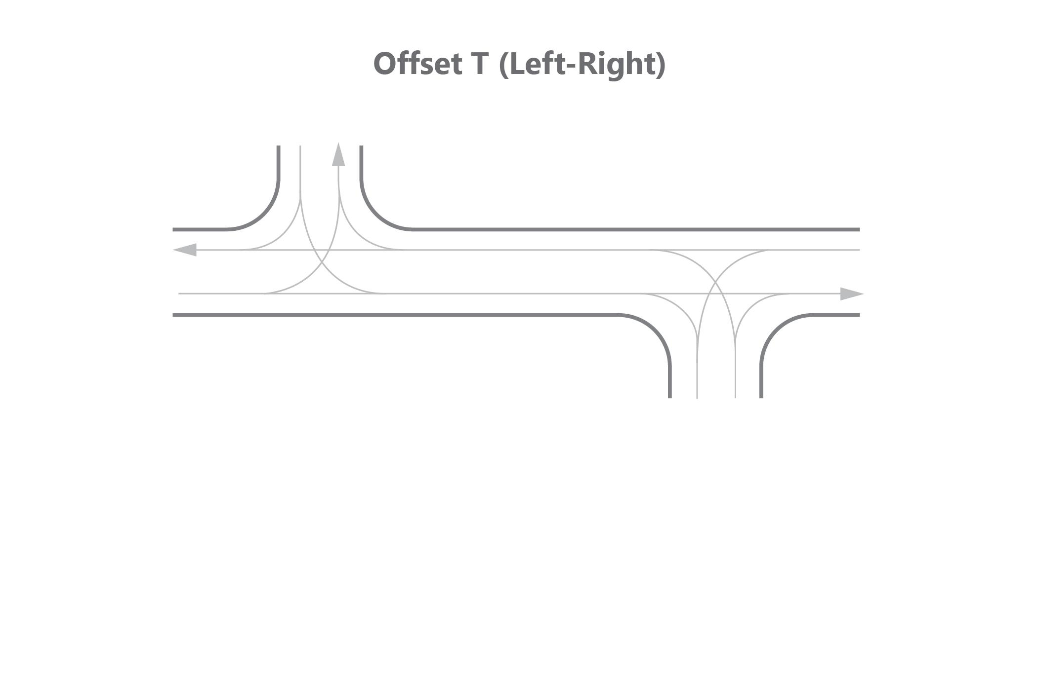
Phase 1
Phase 2
Phase 3
Phase 1
Phase 2
Phase 3

Slide 17
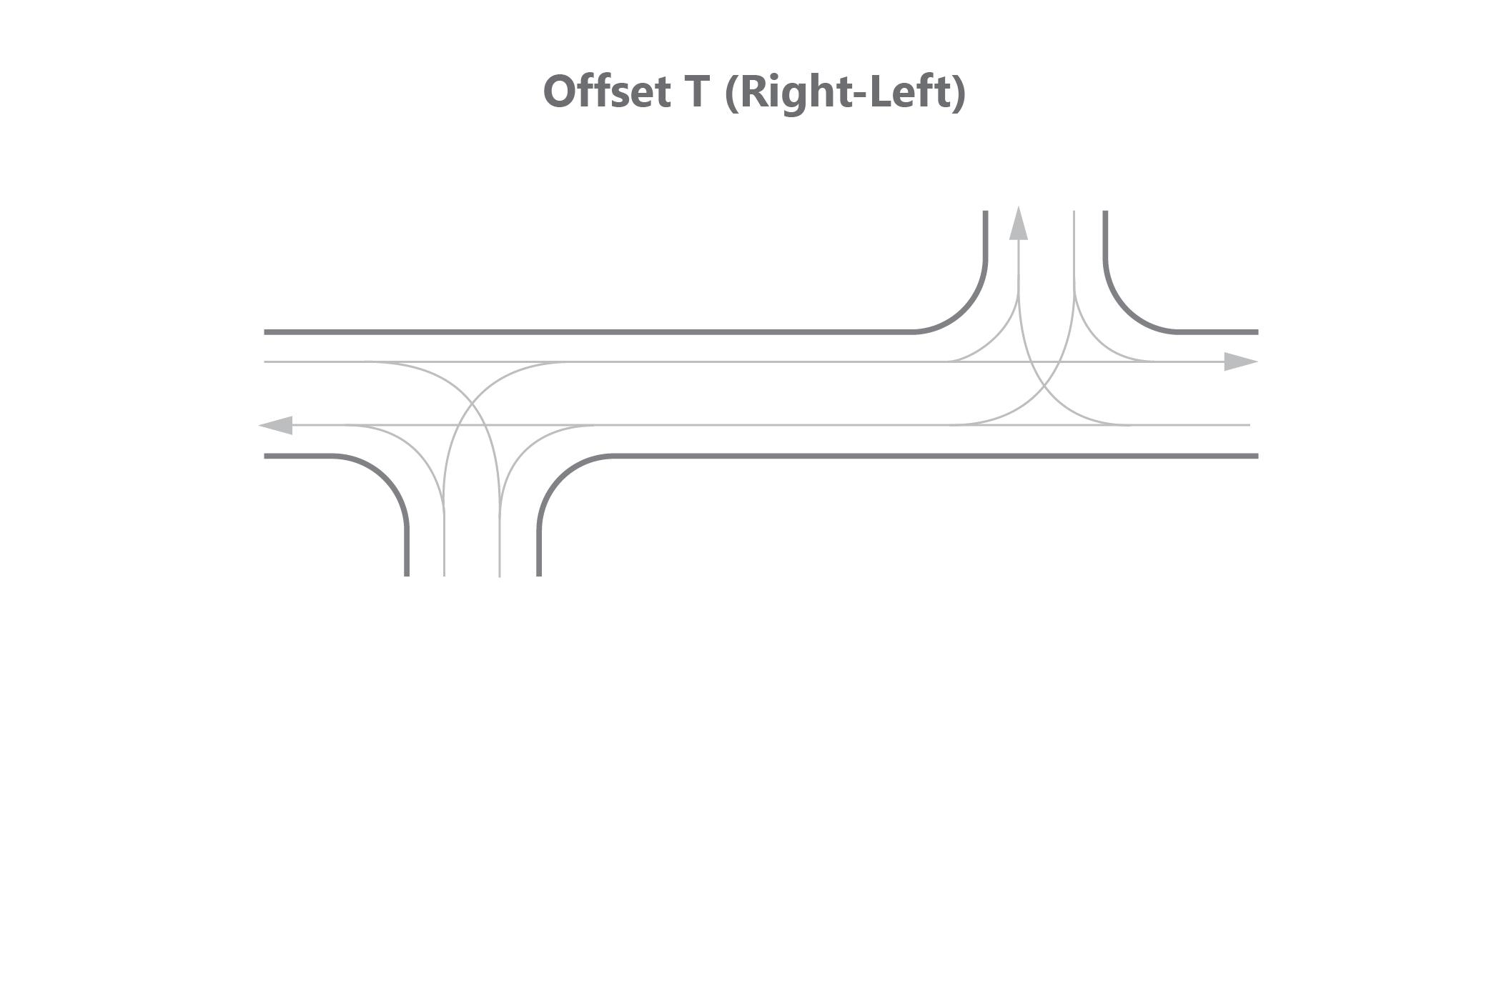
Phase 1
Phase 2
Phase 3
Phase 1
Phase 2
Phase 3

Slide 18
Phase 1
Phase 2
Phase 3

Slide 19
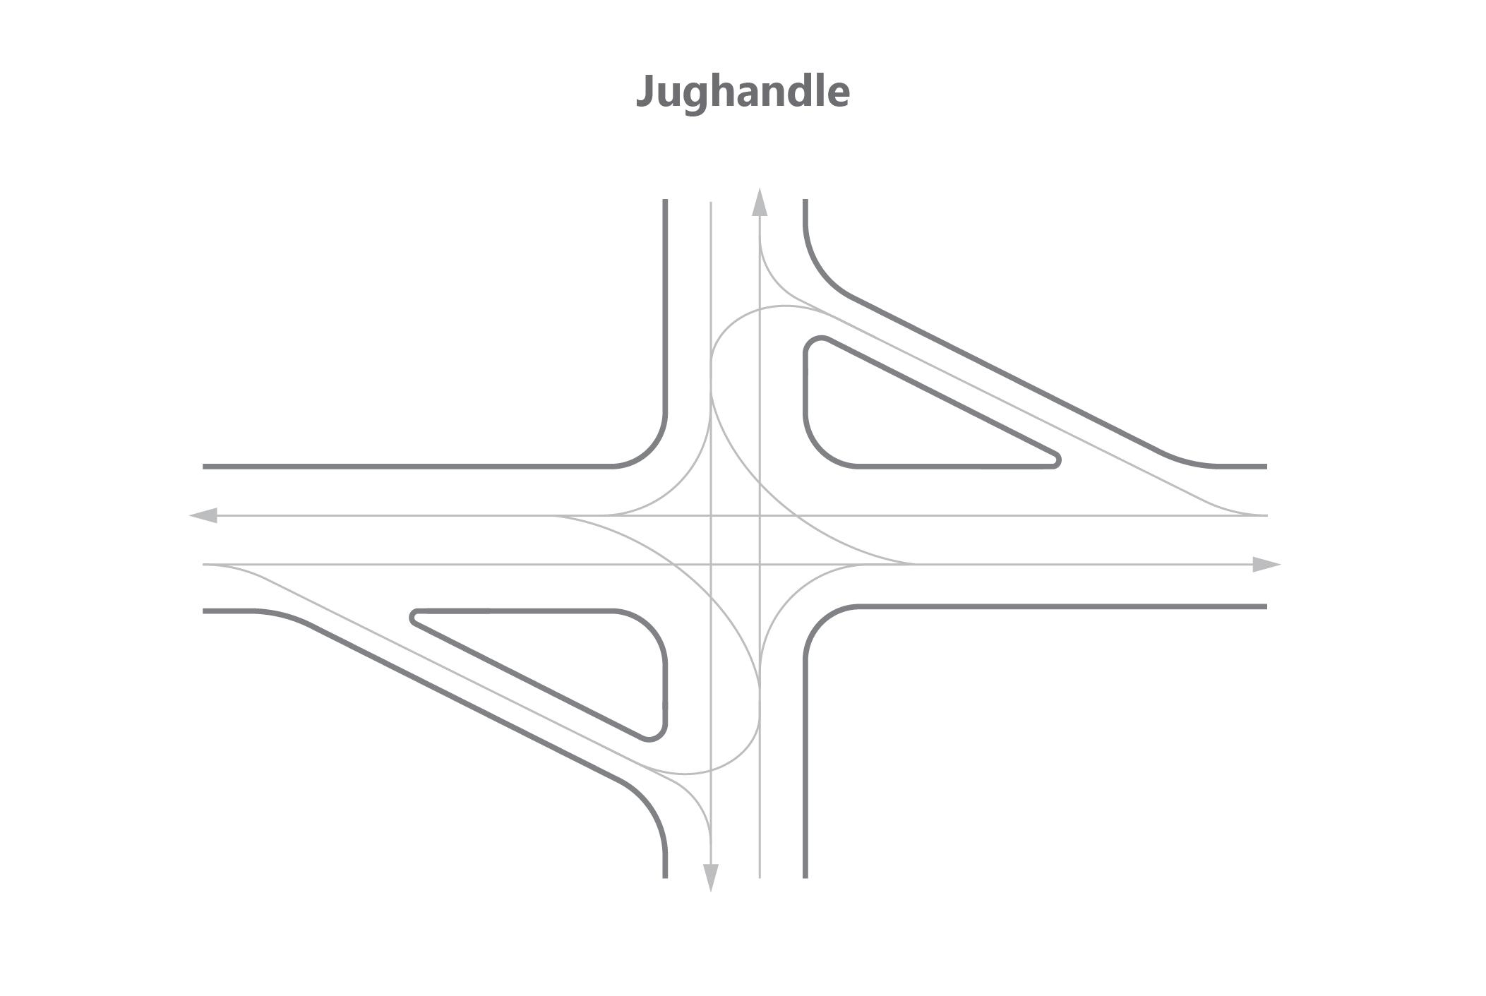
Phase 1
Phase 2
Phase 1
Phase 2
Phase 3
Phase 1
Phase 2

Slide 20
At-Grade Intersections
Grade-Separated Intersections

Slide 21
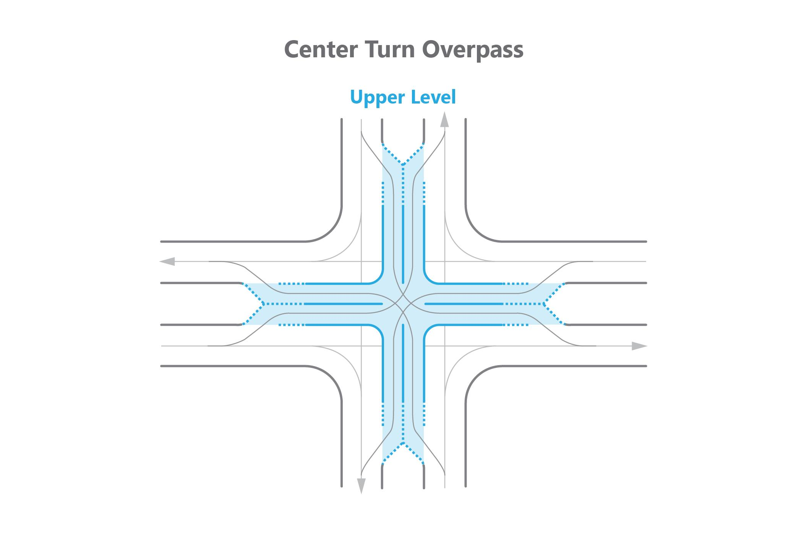
Phase 1
Phase 2
Phase 1
Phase 2

Slide 22
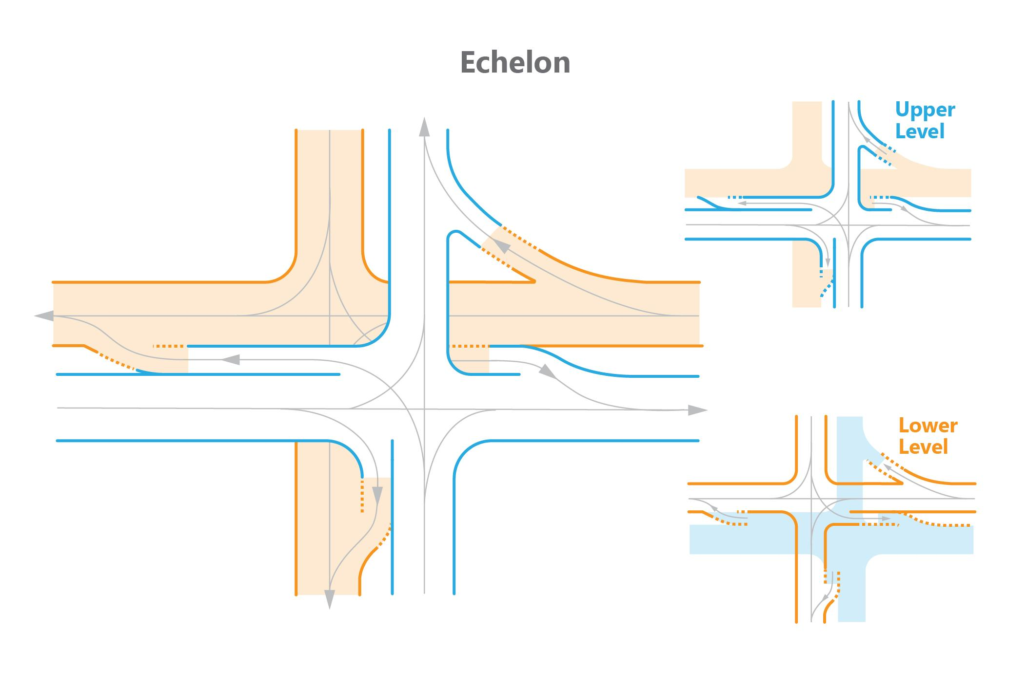
Phase 1
Phase 2
Phase 1
Phase 2

Slide 23
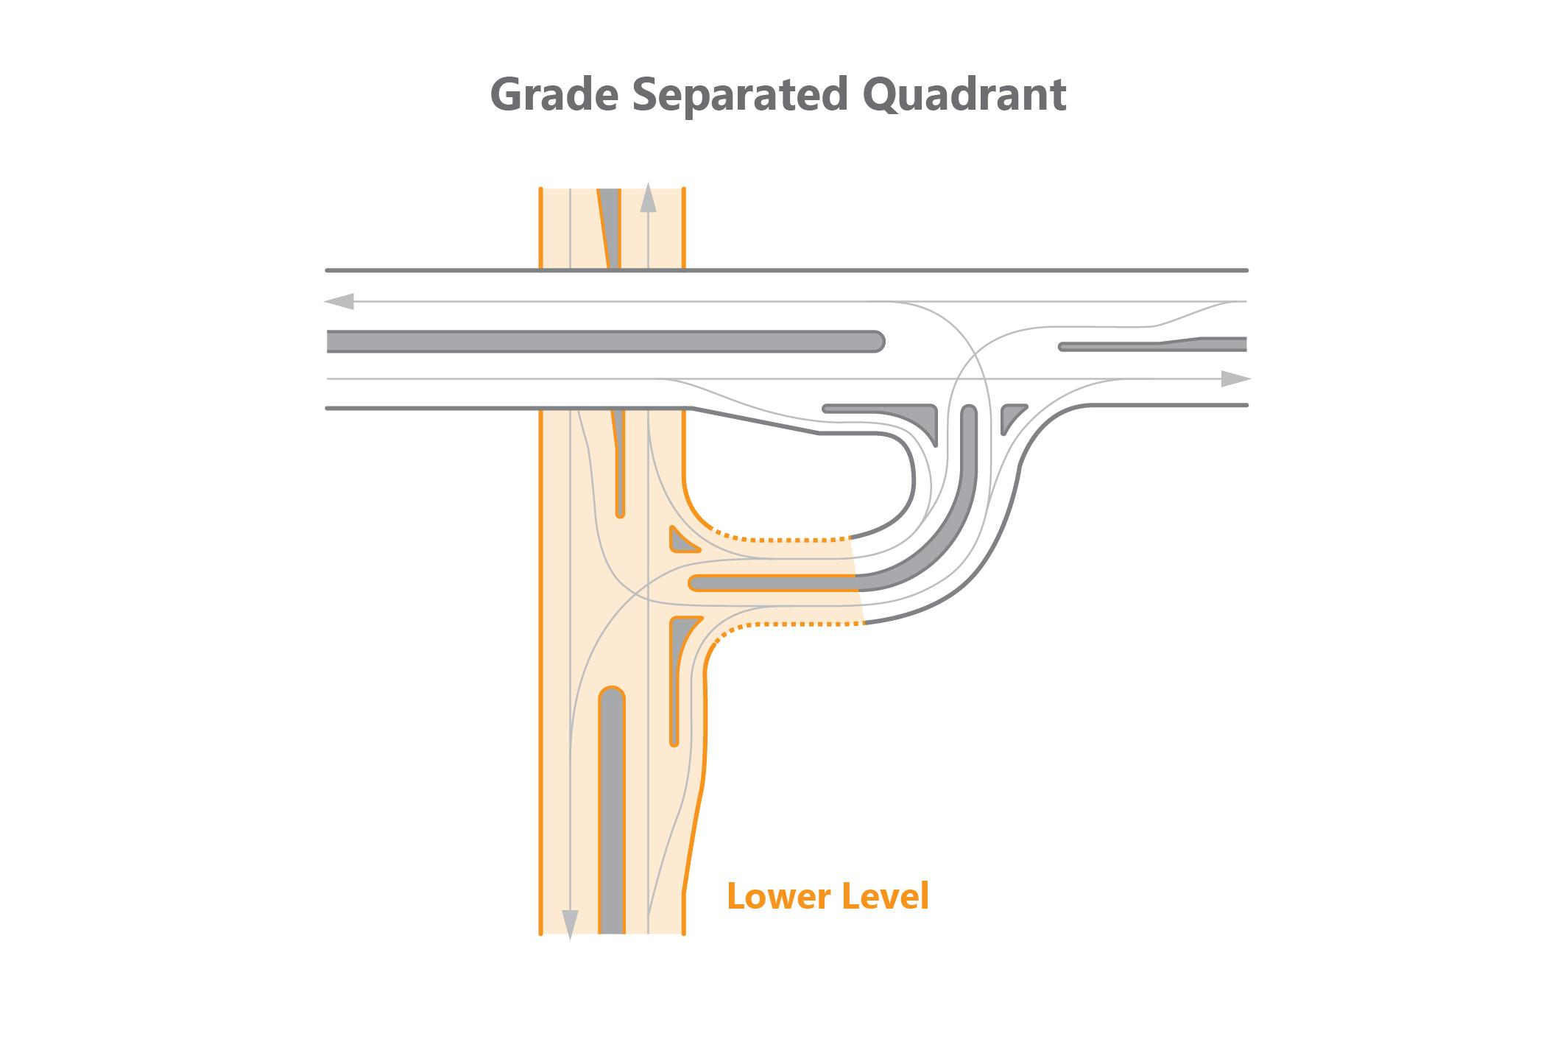
Phase 1
Phase 2
Phase 3
Phase 1
Phase 2
Phase 2
Phase 3

Slide 24
Phase 1
Phase 2
Phase 1
Phase 2
Phase 1
Phase 2
Phase 1
Phase 2

Slide 25
Phase 1
Phase 2
Phase 1
Phase 2
Phase 1
Phase 2
Phase 1
Phase 2

Slide 26
Phase 1
Phase 2
Phase 1
Phase 2
Phase 1
Phase 2
Phase 1
Phase 2

Slide 27
Phase 1
Phase 2
Phase 1
Phase 2
Phase 1
Phase 2
Phase 1
Phase 2

Slide 28
Phase 1
Phase 2
Phase 1
Phase 2
Phase 1
Phase 2
Phase 1
Phase 2

Slide 29
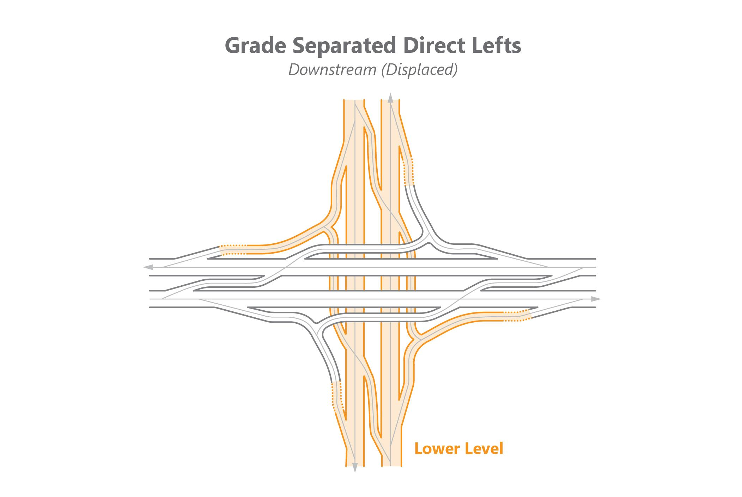
Phase 1
Phase 2
Phase 1
Phase 2
Phase 1
Phase 2
Phase 1
Phase 2

Slide 30
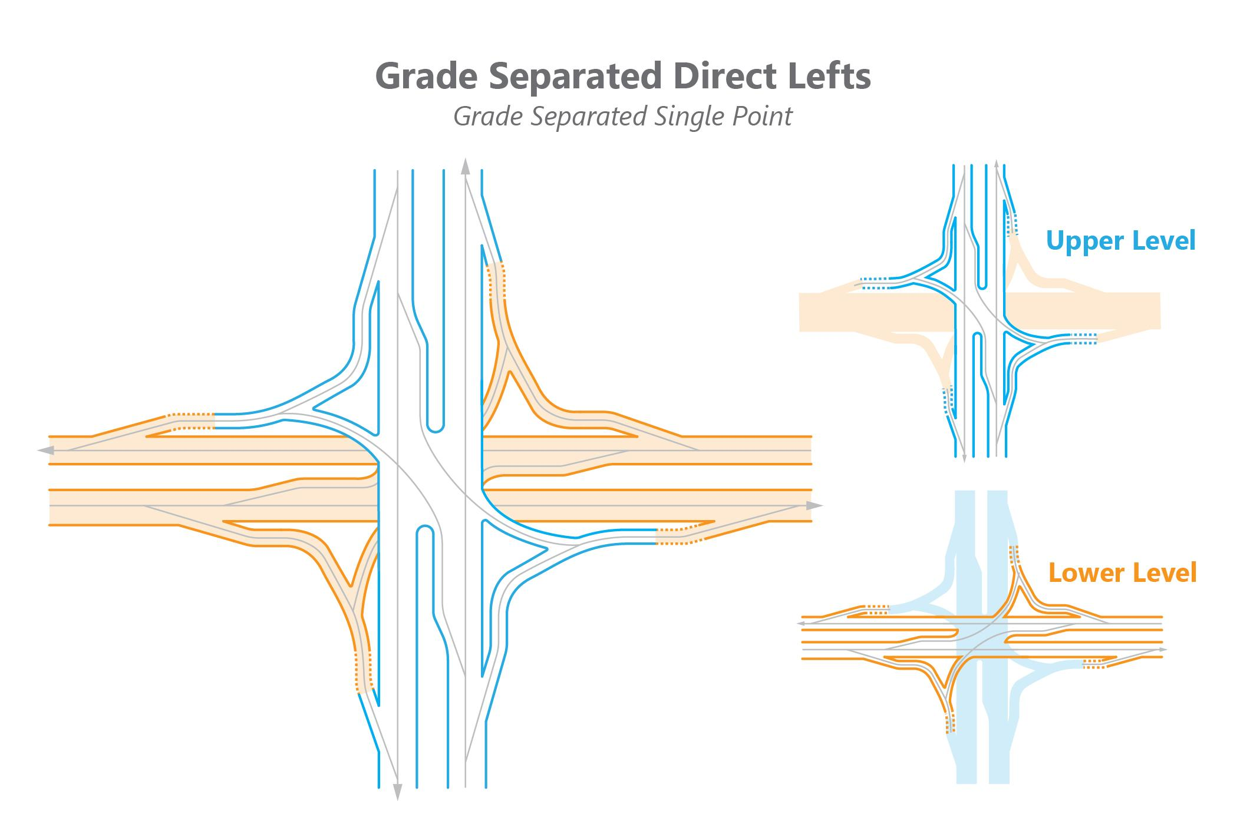
Phase 1
Phase 2
Phase 1
Phase 2

Slide 31
At-Grade Intersections
Alternative Service Interchanges

Slide 32
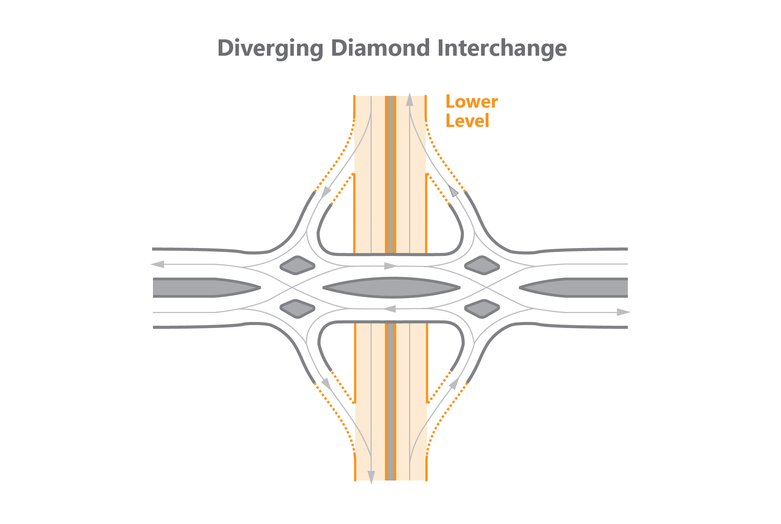
Phase 1
Phase 2
Phase 1
Phase 2

Slide 33
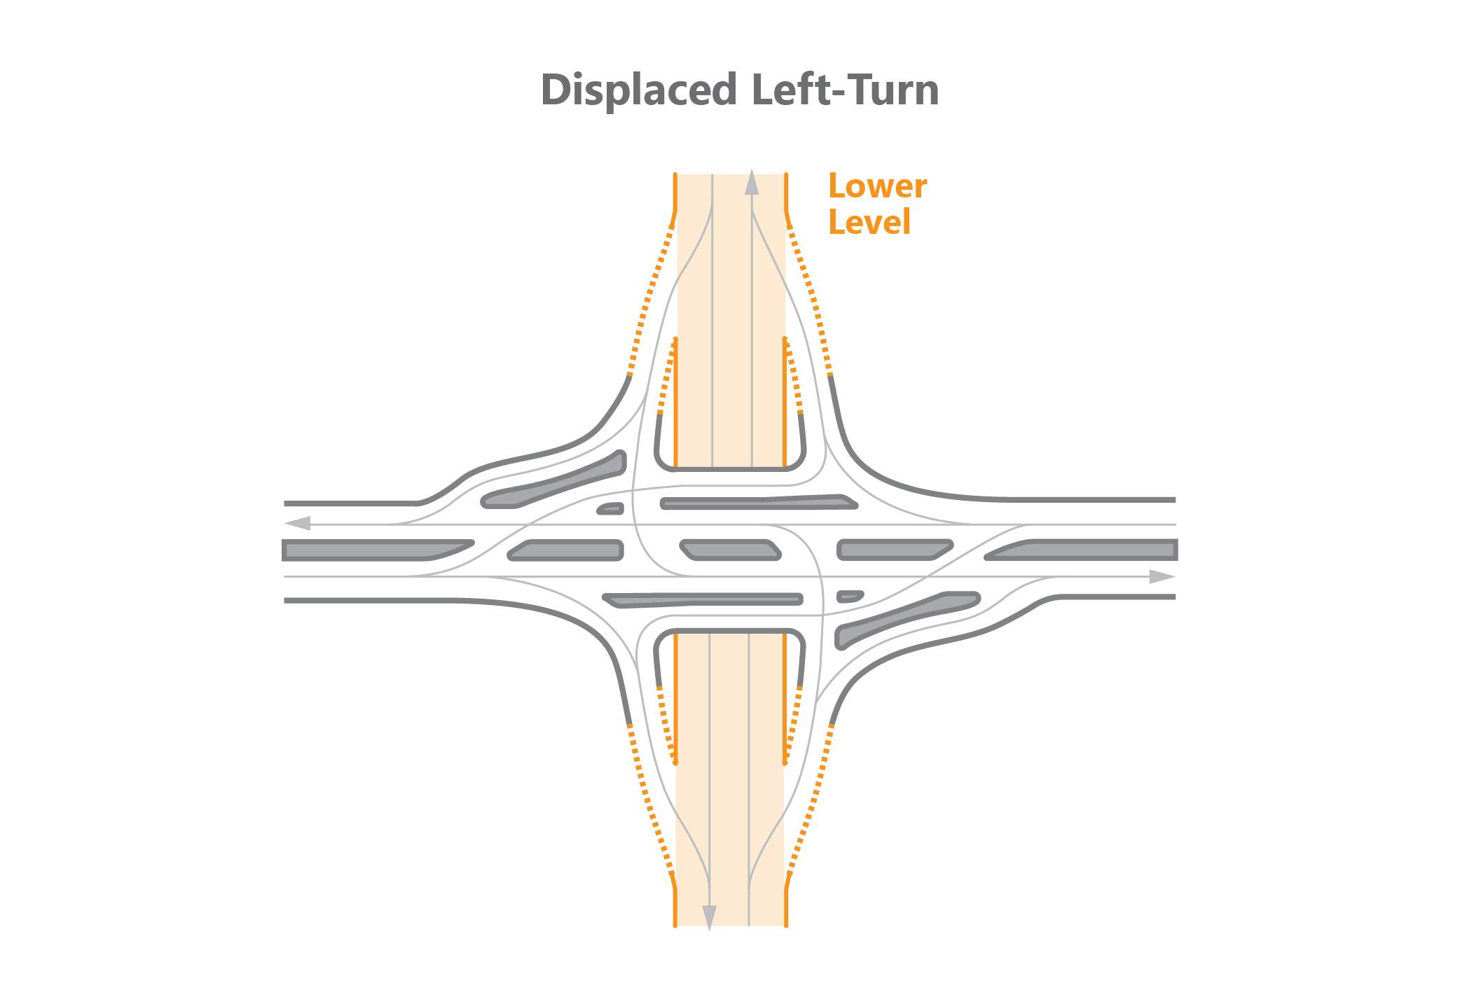
Phase 1
Phase 2
Phase 1
Phase 2
Phase 3
Phase 1
Phase 2
Phase 3
Phase 1
Phase 2

Slide 34
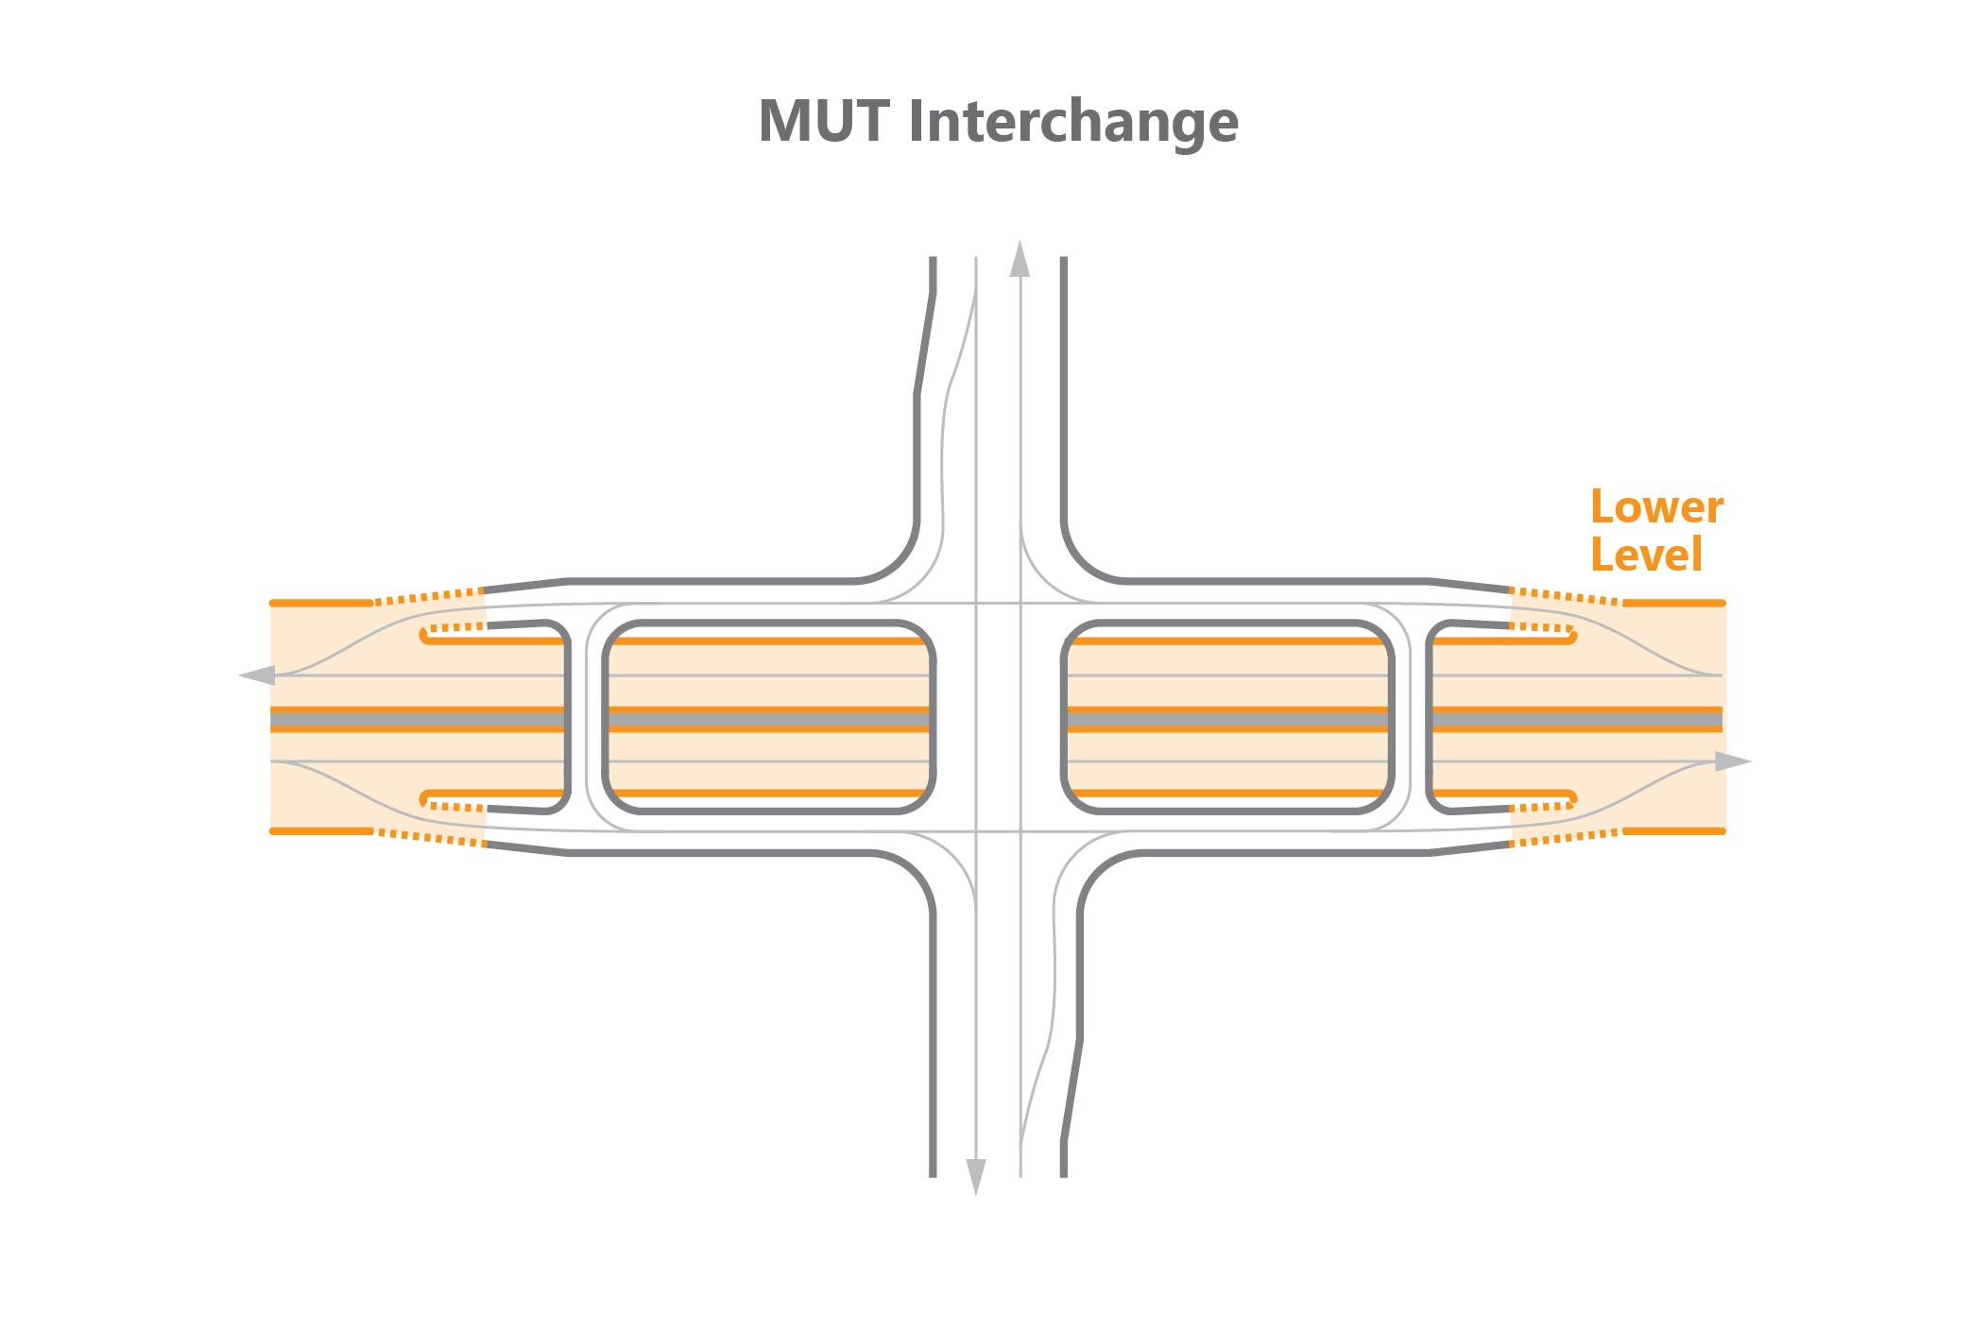
Phase 1
Phase 2
Phase 1
Phase 2
Phase 1
Phase 2
Phase 1
Phase 2

Slide 35
Phase 1
Phase 2
Phase 3

Slide 36
Phase 1
Phase 2

Slide 37
Phase 1
Phase 2
Phase 1
Phase 2

Slide 38
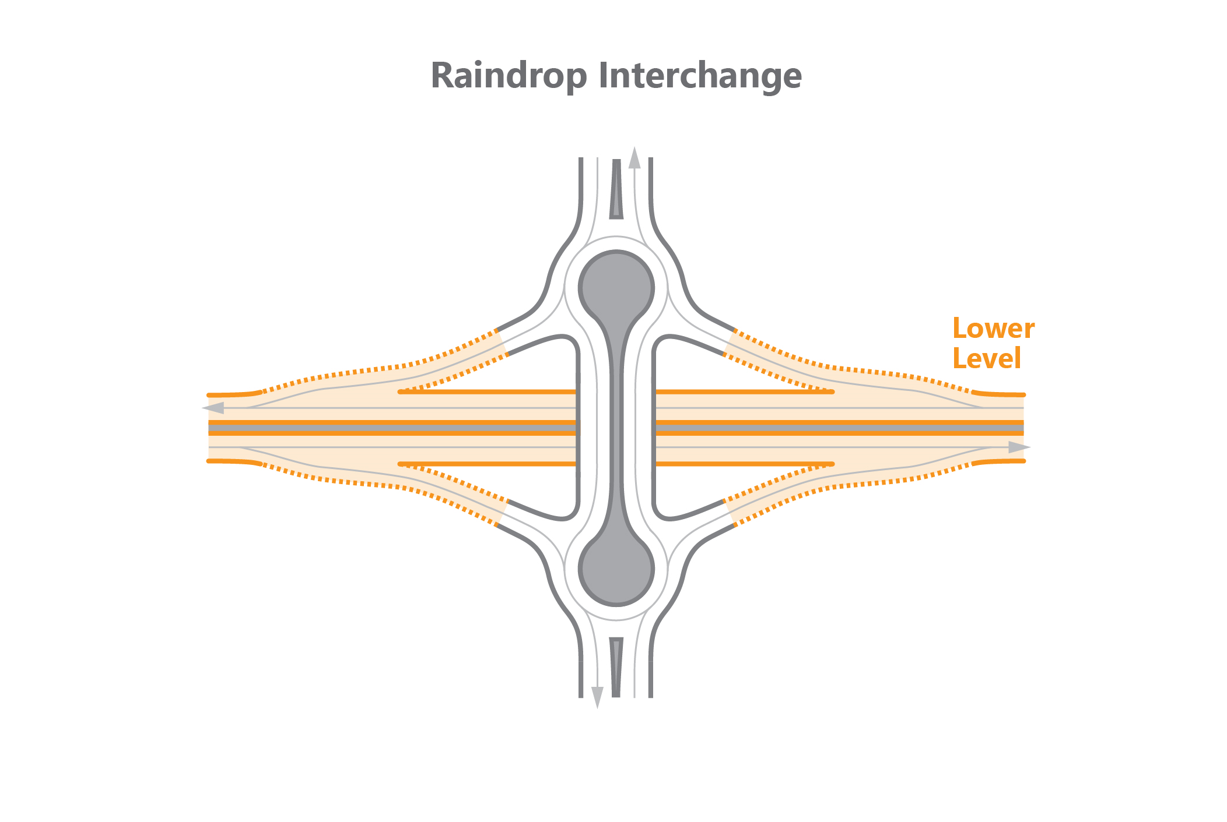
Phase 1
Phase 2
Phase 1
Phase 2

